Slide 1
Foundations of Modern Software Systems
Instructor: Piyush Goel
N.M.A.M. Institute of Technology

Slide 2
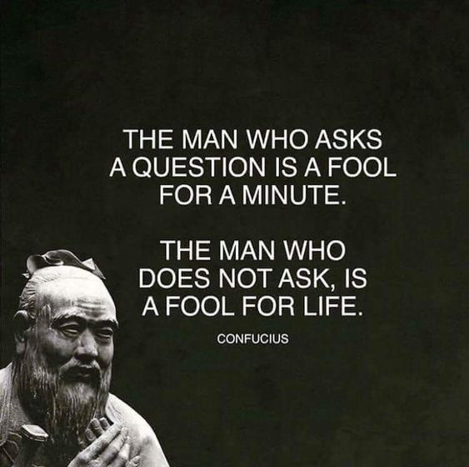
Let’s keep it interactive, please! :)

Slide 3
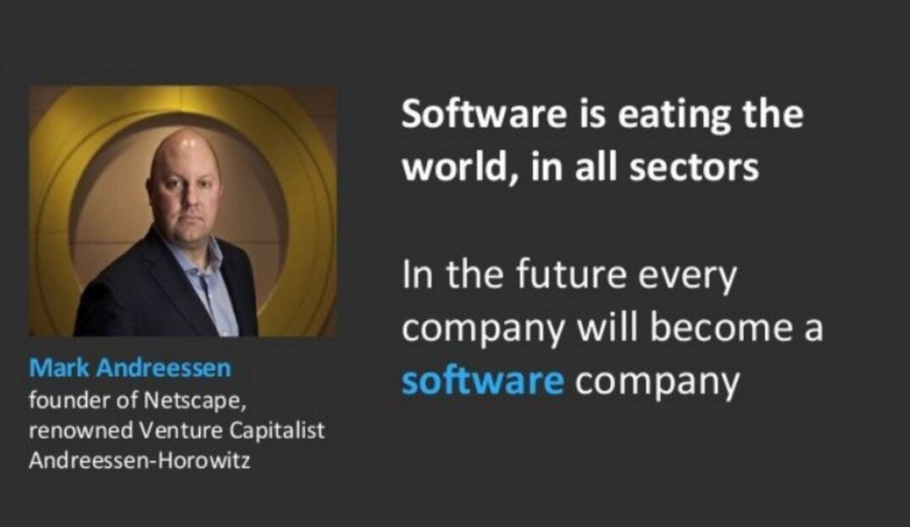
Software has taken over the world & our daily lives.
* https://a16z.com/
* https://en.wikipedia.org/wiki/Marc_Andreessen

Slide 4
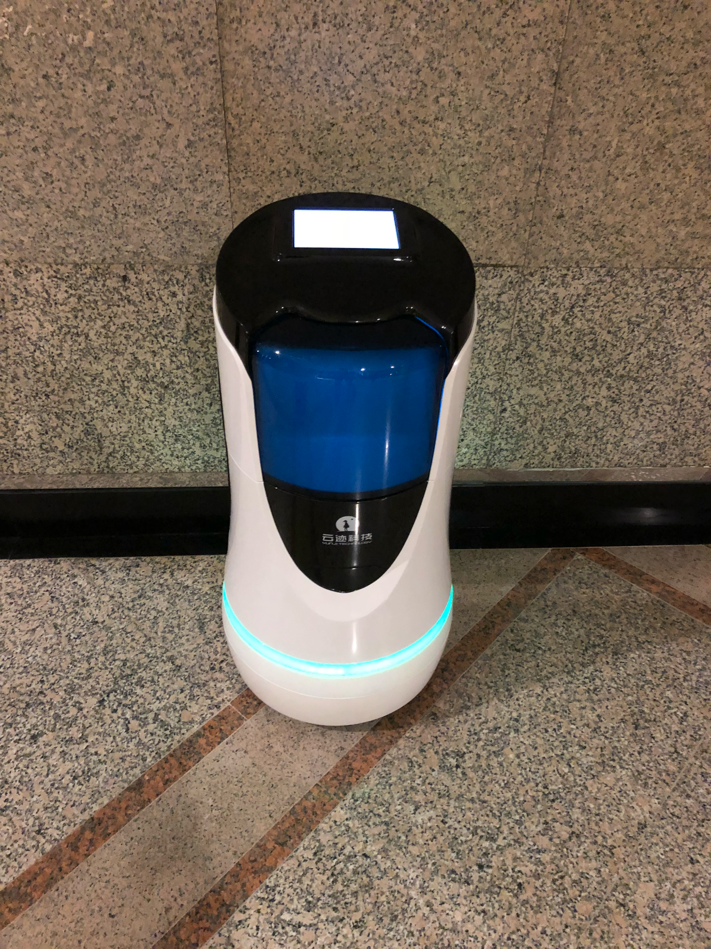
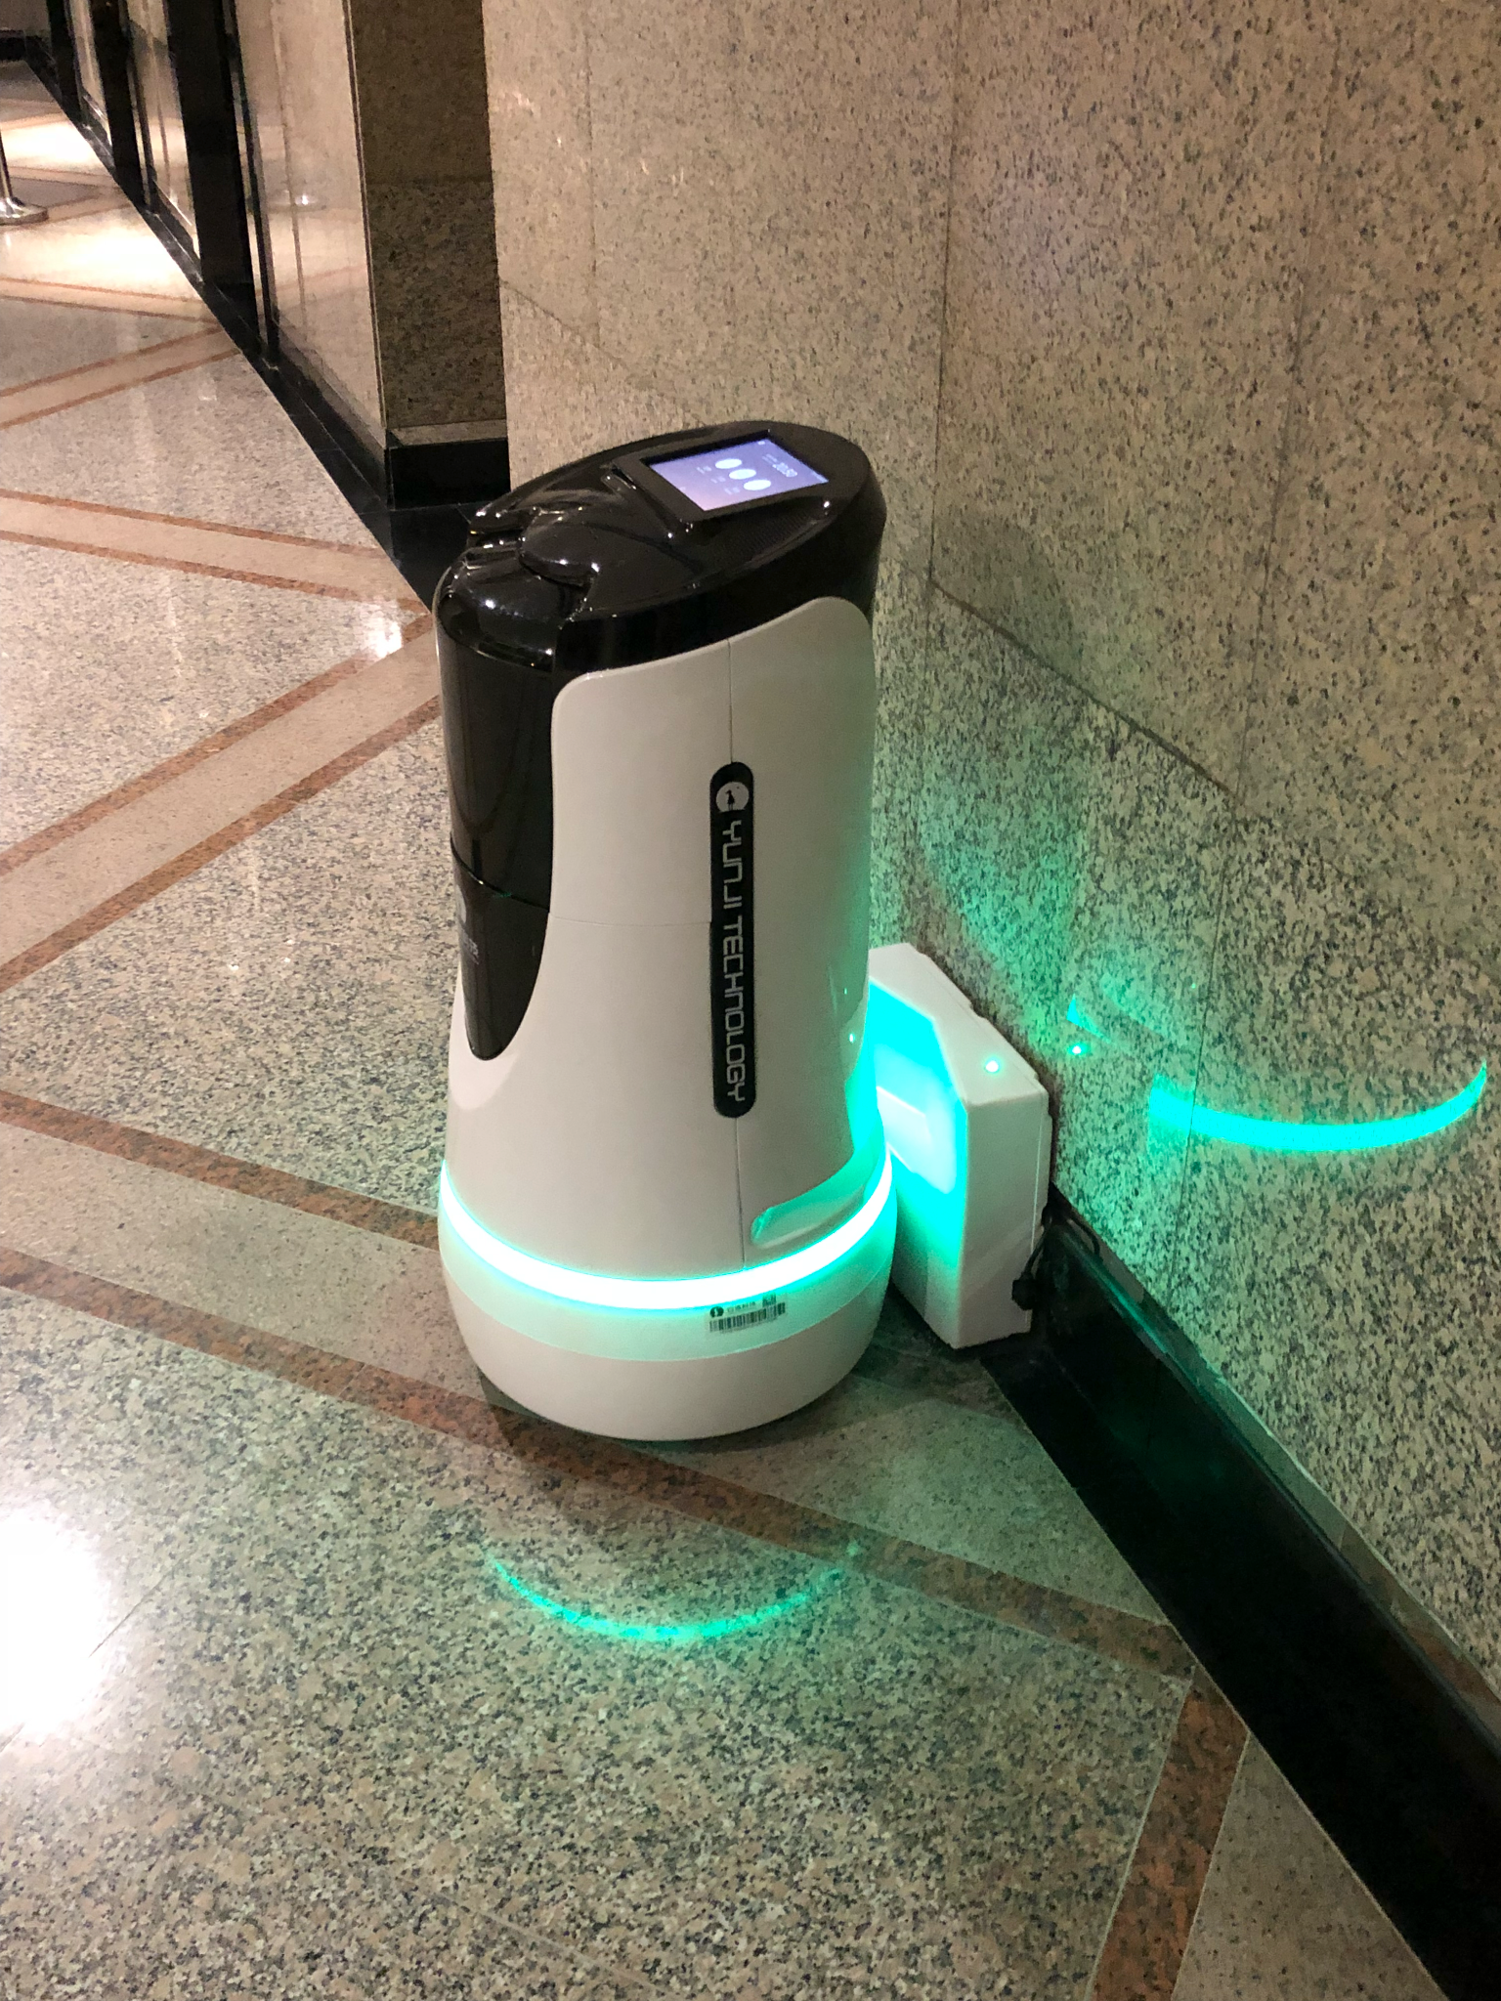
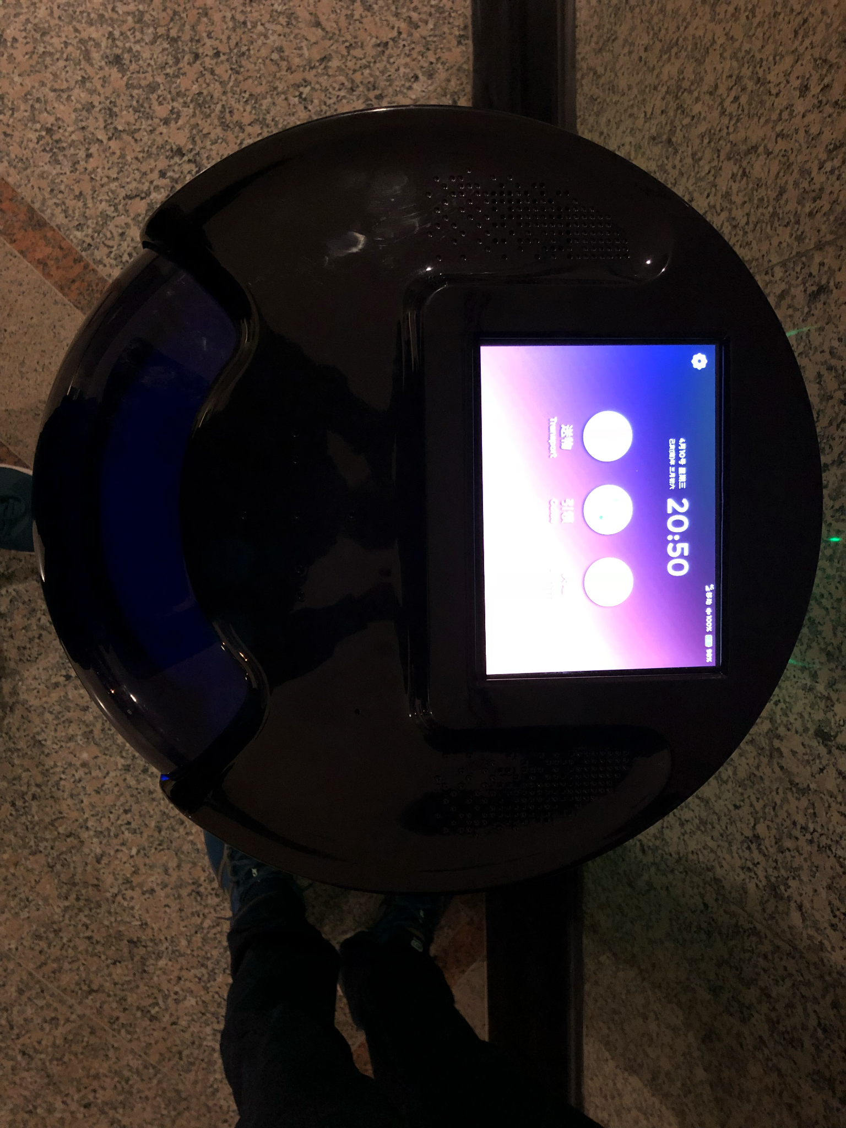
A courier delivery robot in a Shanghai office building.
Circa 2019

Slide 5
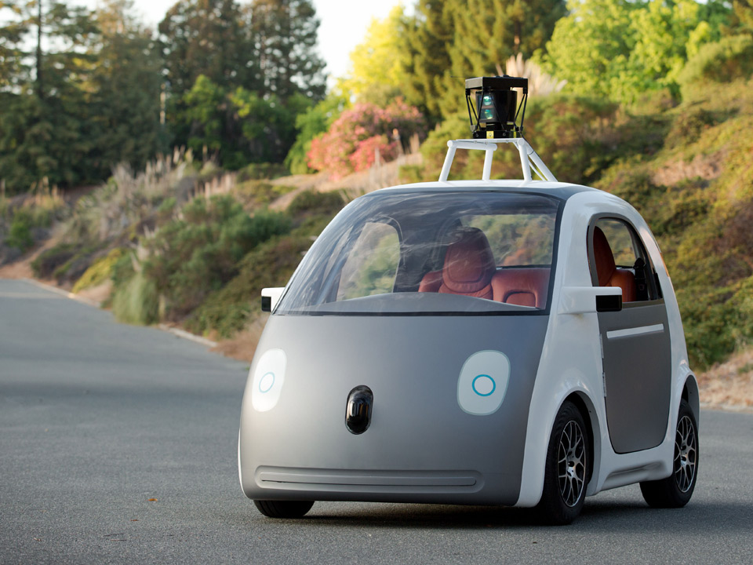
Google’s Self Driving car in San Francisco.

Slide 6
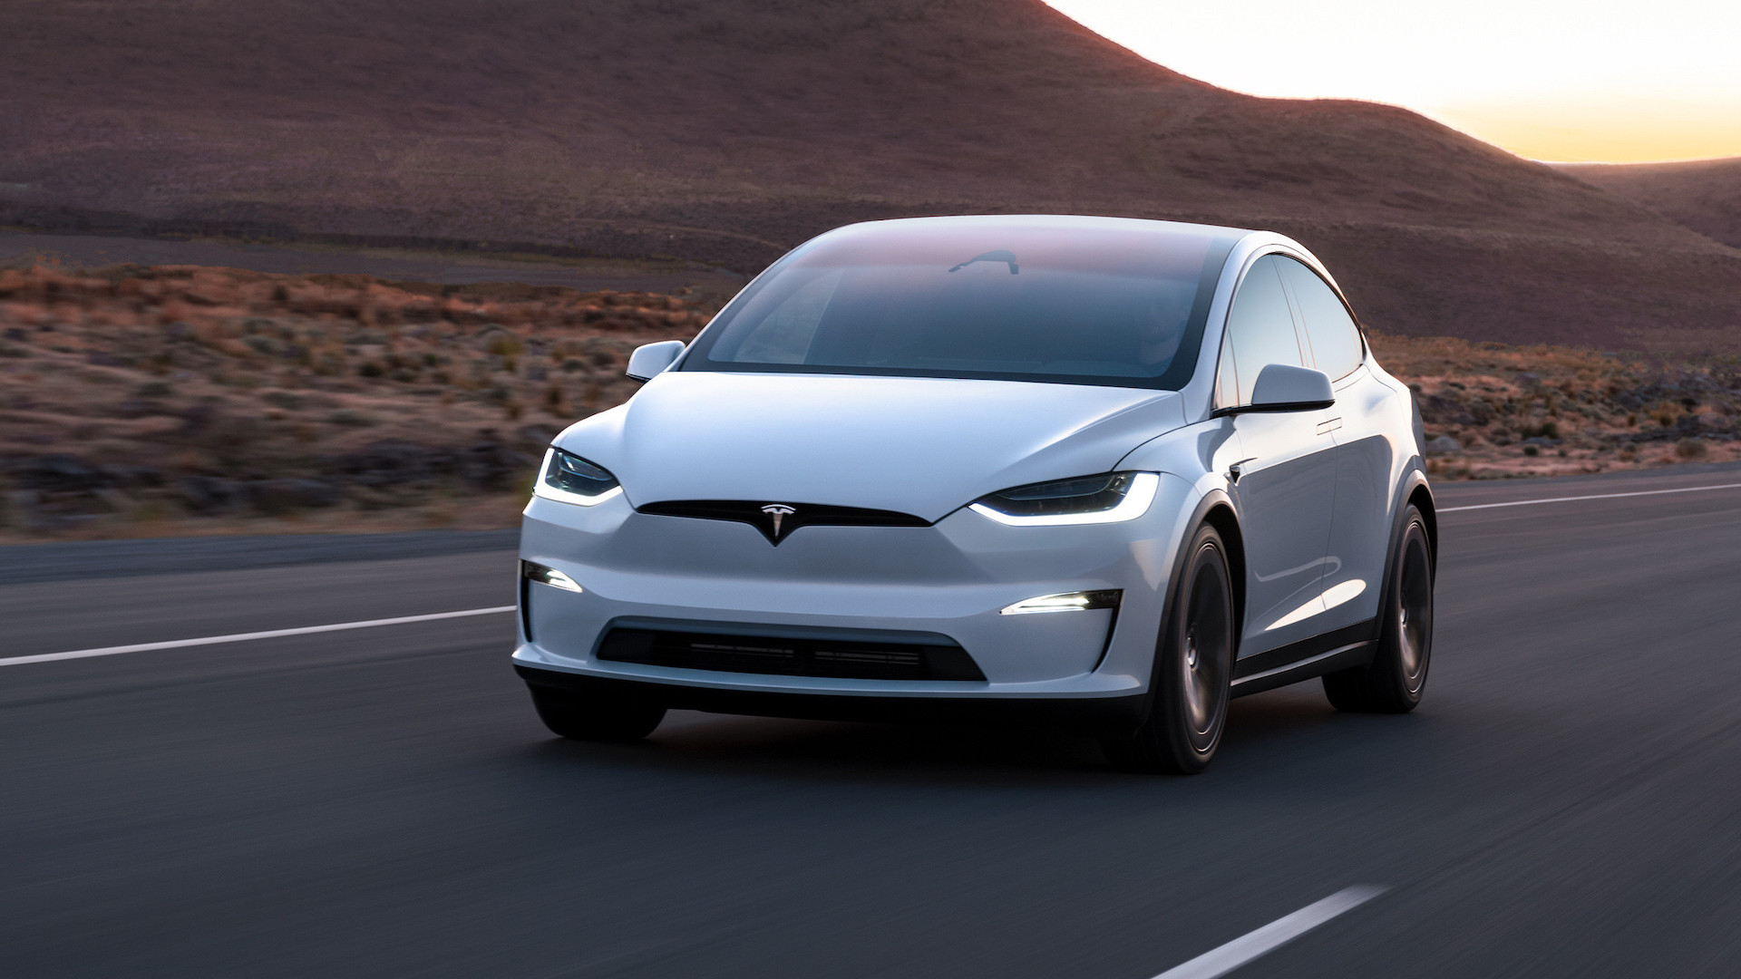
Tesla’s Self-Drive Mode

Slide 7
How many of you have used either Swiggy or Zomato to order food?

Slide 8
How many software engineers does Swiggy/Zomato employ?

Slide 9
What are the components of the software stack of a Food Delivery Business?

Slide 10
What are the components of the software stack in a Food Delivery Business?
Let’s examine! =)

Slide 11
What are the components of the software stack in a Food Delivery Business?
Restaurant Listing
Order Management System
User Management
Ratings & Reviews
Abuse Prevention
Image Management (CDN)
Payments Processing
Order Tracking System
Restaurant Management
Delivery Tracking
Delivery Partners Management
Accounting for the Delivery Partners.
Accounting for the Restaurants
Table Booking System
Communications (SMS/Push Notifications)
And many more…..

Slide 12
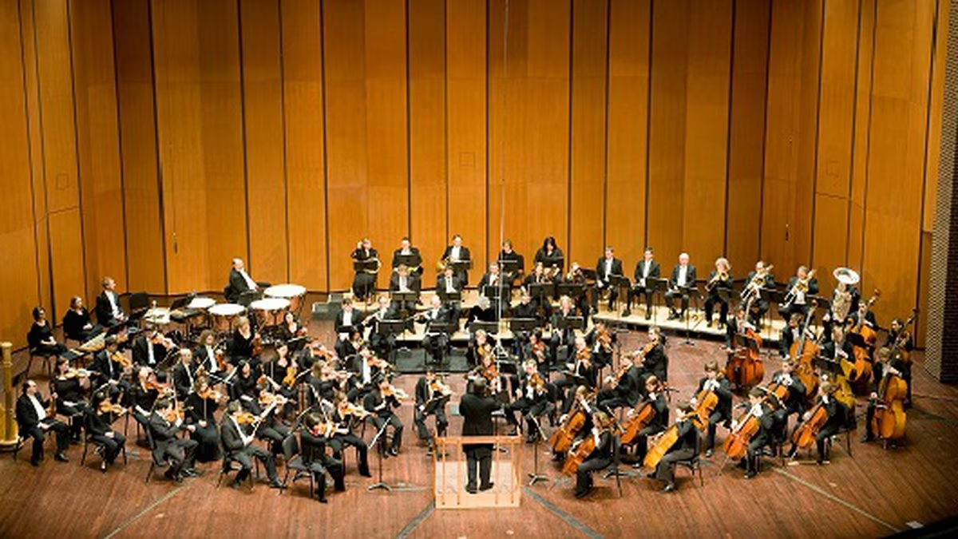
What are the components of the software stack in a Food Delivery Business?
Restaurant Listing
Order Management System
User Management
Ratings & Reviews
Abuse Prevention
Image Management (CDN)
Payments Processing
Order Tracking System
Restaurant Management
Delivery Tracking
Delivery Partners Management
Accounting for the Delivery Partners.
Accounting for the Restaurants
Table Booking System
Communications (SMS/Push Notifications)
And many more…..
It’s a Symphony of Software Modules!

Slide 13
What are the building blocks of these massive, and sophisticated pieces of software?

Slide 14
Objectives of the Course
Understand the fundamental blocks of any large scale software applications.
Experiment with Basic Tools, and Technologies.
Get exposed to how Computer Science concepts come together for building a working real life application.
And anything else the students want to learn! :)) Open-ended.

Slide 15
Does everyone use Chrome Browser?

Slide 16
Chrome Dev Tools?
https://developer.chrome.com/docs/devtools/

Slide 17
How many have tried their hands with Python or Ruby?

Slide 18
What are the building blocks of these massive, and sophisticated pieces of software?

Slide 19
Building Blocks

Slide 20
Building Blocks (Abstract)
Storage
Compute
Networking & Security

Slide 21
Building Blocks (Abstract)
Storage
Compute
Networking & Security
Data Structures and Algorithms

Slide 22
Building Blocks - Storage
Storage
Compute
Networking & Security

Slide 23
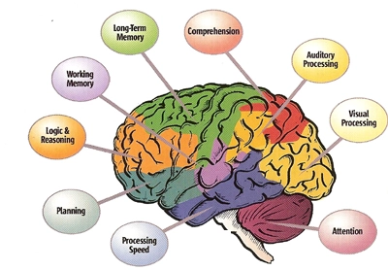
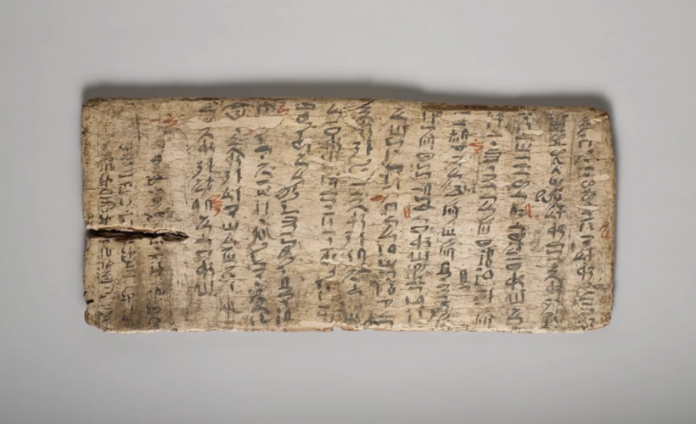

Building Blocks - Storage
Necessary to provide the concept of “Memory” to machines.
Humans have brains and memory centers.
Short Term Memory
Long Term Memory
Even Longer Term Memoization
Tablets
Books
Ledgers

Slide 24
Building Blocks - Storage
Hardware
Tape Drives
Mechanical Drives
Solid State Drives
RAM
Software
In Memory Caches
Databases: 4-5 different types depending on the “characteristics” of the data they store.
We will cover these in detail in the coming sessions.

Slide 25
Building Blocks - Compute
Storage
Compute
Networking & Security

Slide 26

Building Blocks - Compute
Represents the “Execution” portion of any software.
Instruction Execution on the Processor.
Different Models of Execution
Process Driven
Thread Driven
Security Parameters
System Level
User Level
Scheduling
Interesting Class of Problems
Packaging
Vanilla Executables
Containers
Virtual Machines
Compute Capacity
Processor Architecture
Clock Frequency
Memory

Slide 27
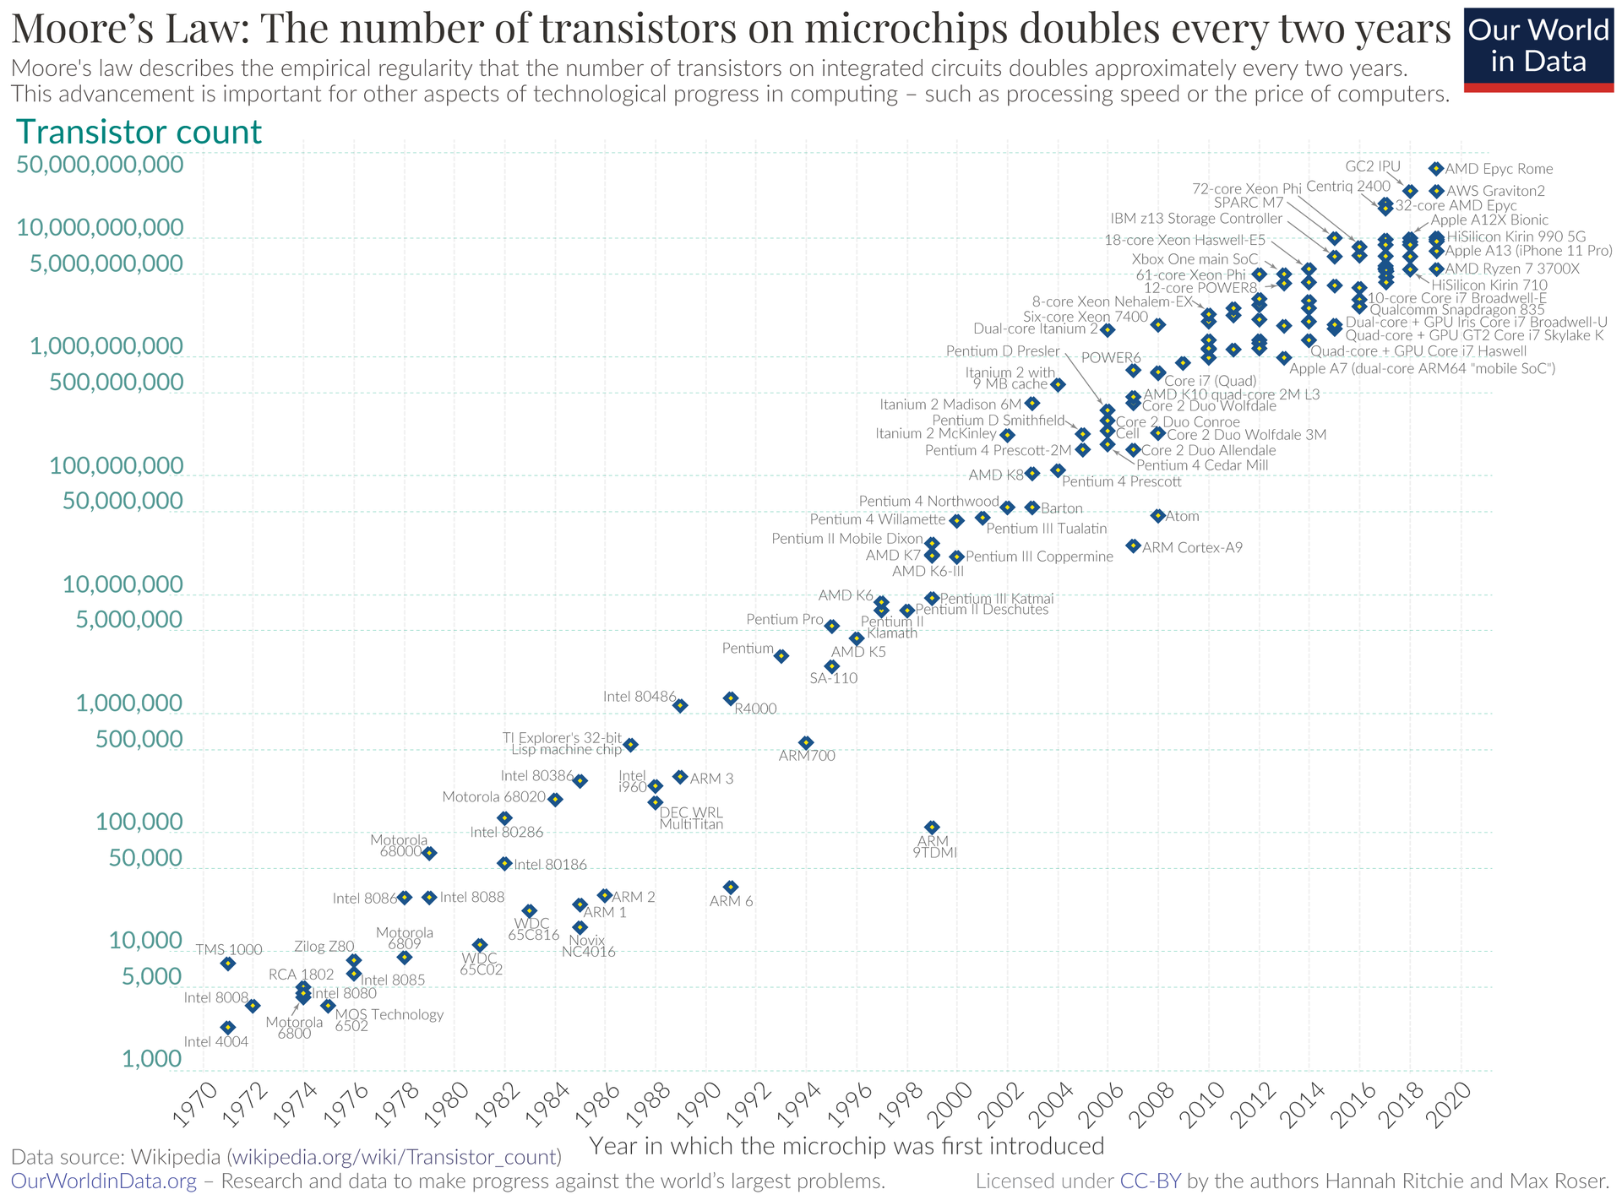
Building Blocks - Compute - Moore’s Law
The number of transistors on computer chips doubles approximately every two years.
Gordon Moore, Founder of Intel

Slide 28
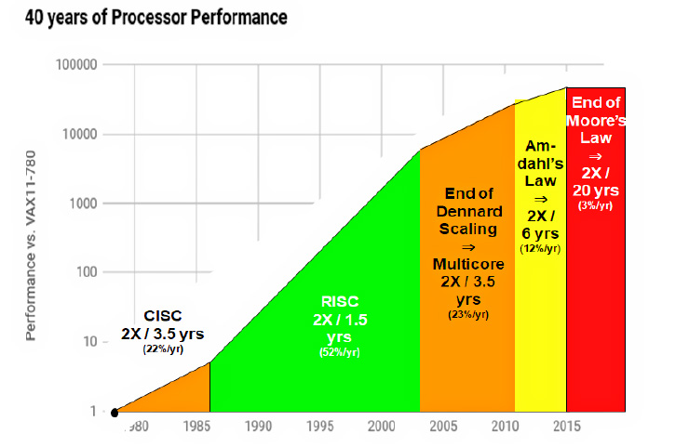
Building Blocks - Compute - Moore’s Laws - Consequence
Advances in Processor Technology have slowed down.
Amount of Compute Power that can be packed in a single processor can’t be increased substantially.
Compute Power = f(#Processors)
Imposes challenges on programming languages!
What could they be?

Slide 29
Building Blocks - Networking & Security
Storage
Compute
Networking & Security

Slide 30
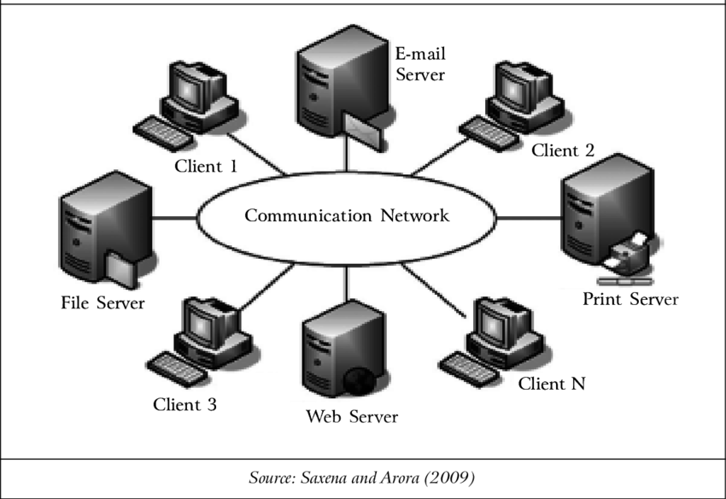
Building Blocks - Networking & Security
Networking represents the “Communications” portion of any software.
Human “communication” happen via verbal languages.
Protocols?
Agreement/Consensus.
Knowledge Sharing.
Rules of how data bits (Information) is exchanged by machines.
Parameters
Bandwidth
Transfer Protocols (Dial-up, Broadband, 4G, 5G)
Human Languages: 39 bits/second *
* https://www.science.org/content/article/human-speech-may-have-universal-transmission-rate-39-bits-second

Slide 31
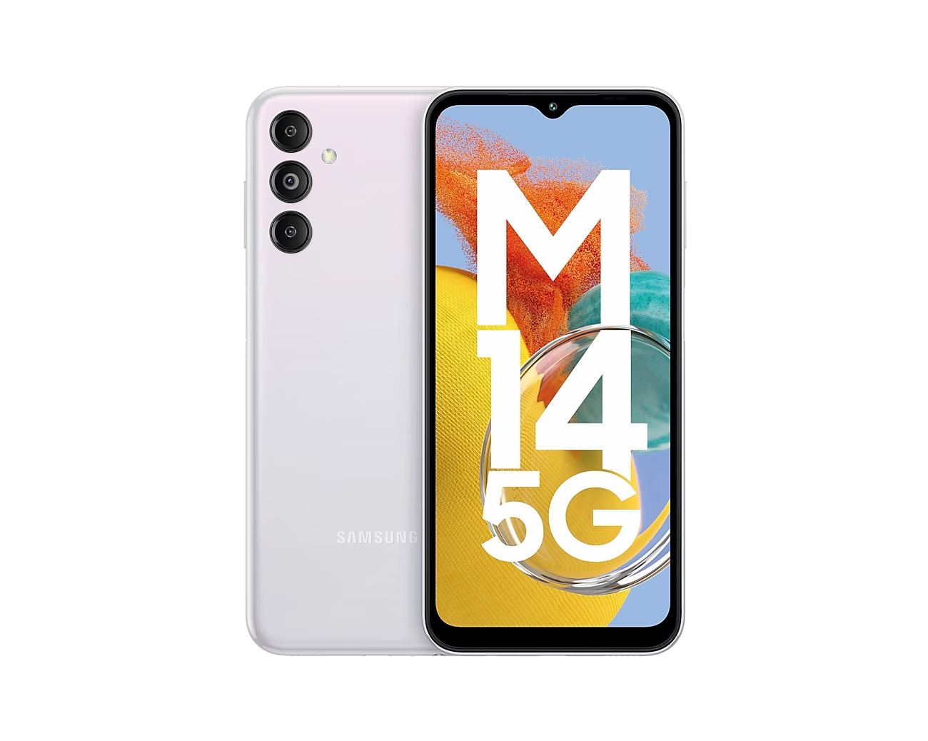
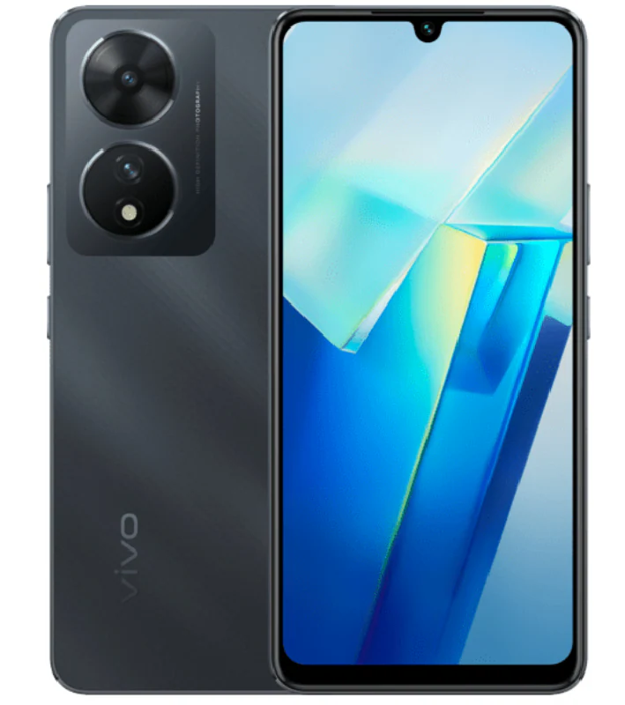
Let’s take a real-life example!
How do you define the “Storage” capacity?
How do you define the “Compute” capacity?
How do you define the “Networking/Communications” capacity?

Slide 32
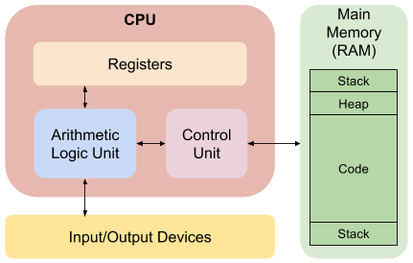
Turtles all the way down ** - Processors
Storage
Registers, CPU Caches (L1/L2)
Main Memory (RAM)
Compute
CPU
Registers
Network & Security
Input/Output Devices
Internal I/O Bus
Security Switch in the Instruction Set. (Super Mode)
High-Level x86_64 Architecture from Intel*
* https://www.aldeid.com/wiki/Category:Architecture/x86-assembly
** https://en.wikipedia.org/wiki/Turtles_all_the_way_down

Slide 33
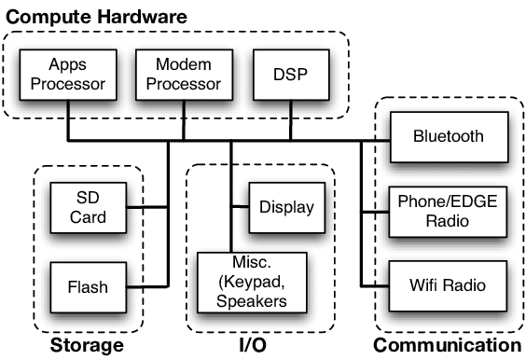
Turtles all the way down - Mobile Device
Storage
SD Card
Flash Storage
SQLite
Computer
Processor (ARM etc.)
Networking (Communication) & Security
Bluetooth
Phone/Edge Network
Wifi
High-Level Cell Phone Architecture
* https://evelta.com/blog/a-quick-introduction-to-smartphone-architecture/

Slide 34
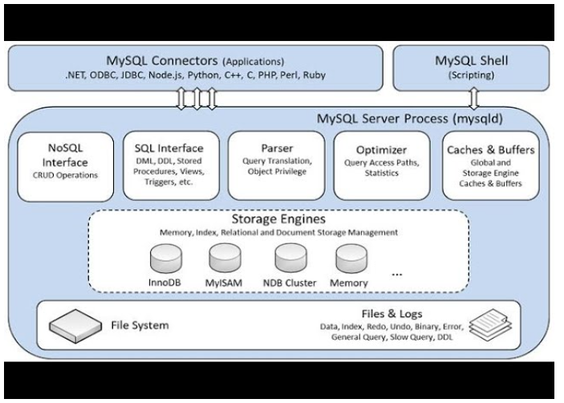
Turtles all the way down - Databases
Storage
File System Interfaces
Storage Engines
Computer
Parser
Optimiser
Query Executors
Networking & Security
Network Interfaces
Connection Management
MySQL High-Level Schematic
* https://www.i2tutorials.com/architecture-of-mysql/

Slide 35
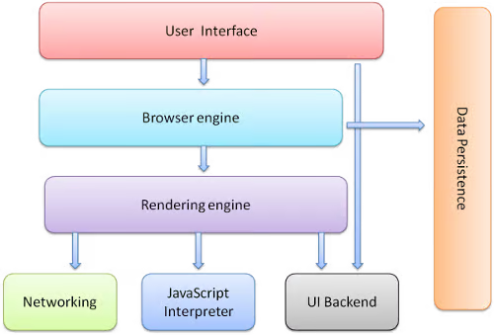
Turtles all the way down - Browsers
Storage
Data Persistence
Compute
Browser Engine, Rendering Engine
JavaScript Interpreter
Networking & Security
Networking Interface
High-Level Schematic of a Web-Browser
* https://blog.quastor.org/p/architecture-web-browsers

Slide 36
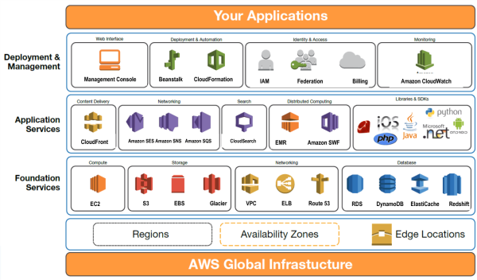
Turtles all the way down - Cloud Computing Foundation Services
Storage
File Systems
Database Services
Compute
Virtual Machines
Container Services
Networking & Security
Network Definitions (VPC, ELB, Route53)
Firewalls, GuardDuty
High-Level Schematic of Cloud Services

Slide 37
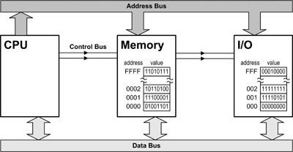
Understanding the Interplay of CPU, Memory, I/O is the holy grail of great software engineering!

Slide 38
Structure of the Course
Module-3: Compute
Process, Threads, Memory.
Servers, Virtual Machines, and Containers.
Application Servers (Web Servers, FTP, Email)
Cloud Computing Basics.
Module-4: Networking
Building Blocks (OSI Layer Models, Network Topologies, Subnets, VPNs, etc.)
Naming Systems (DNS)
Important Protocols
TCP/UDP
HTTP
Web Sockets
Network Security (SSL/TLS)
Other Security Models (Zero-Trust, etc.)
Module-1: Introduction
Module-2: Storage
Basics (Data Types)
Data Storage Fundamentals
Structuring & Querying
Databases
Types
Data Schemas
Object Storage
* We will have a few guest lectures from the other industry experts.

Slide 39
Q&A

